Slide 1
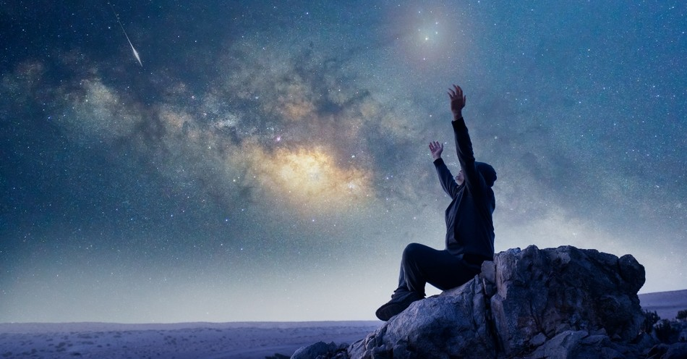
HOW WE EXPERIENCE THE
PRESENSE OF GOD?

Slide 2

I. Read His Word and obey.
a. Your mind full of God's word.
b. Transformation of mind & heart.
c. Spiritual growth
d. Encouragement

Slide 3
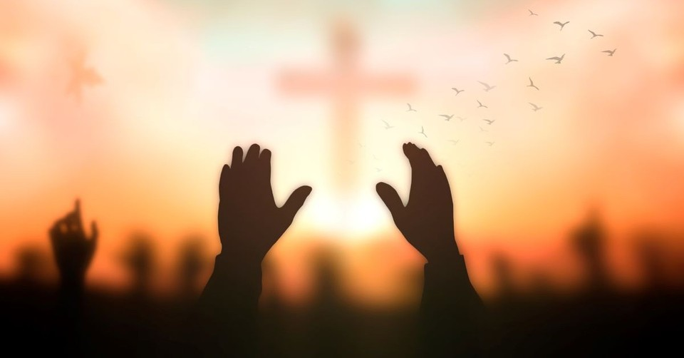
II. The awareness of Jesus Christ.
a. Pray w/out ceasing
b. Schedule prayer
c. Worshipping and thanks giving..

Slide 4

III. Confession.

Slide 5
I.Read His Word and obey.
a.Your mind full of God's word.
b.transpormation of mind &heart.
c.spiritual growth d.encouragement
III.Confession

Slide 6
I.Read His Word and obey.
a.Your mind full of God's word.
b.transpormation of mind &heart.
c.spiritual growth d.encouragement
II.The awareness of Jesus Christ.
a.pray w/out ceasing
b.schedule prayer c.worshipping and thanks giving..
III.Confession

Slide 7


